Slide 1
Lecture 6
Evolutionary Algorithms
Yaohang Li
Department of Computer Science
ODU
Reading for Next Class:
Chapter 3, Russell and Norvig

Slide 2
Review
Last Class
  Heuristic Search
  Local Search
    Hill-Climbing
This Class
  Evolutionary Computing
  Introduction to Genetic Algorithm
Next Class
  More on Genetic Algorithm

Slide 3
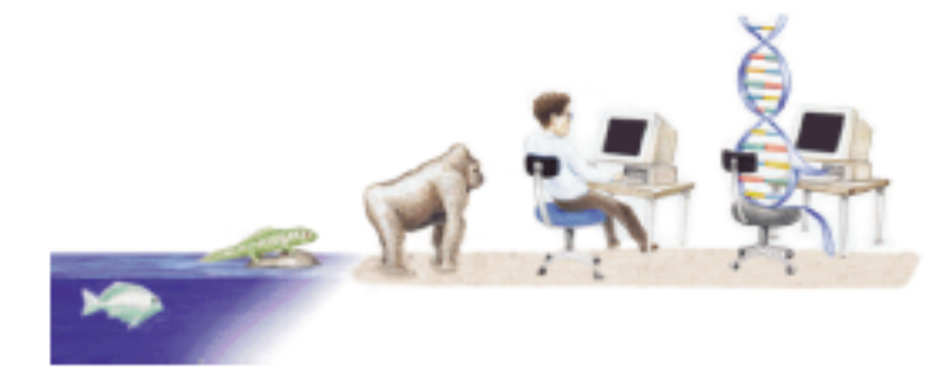
Origin of the Species
Million Years Ago Event
? Origin of Life
3500 Bacteria
1500 Eukaryotic Cells
600 Multi-cellular Organisms
1 Human

Slide 4
Darwinian Evolution
Survival of the Fittest
  All environments have finite resources
    Can only support a limited number of individuals
  Life forms have basic instinct/life cycles geared towards reproduction
  Therefore some kind of selection is inevitable
    Those individuals that compete for the resources most effectively have increased chance of reproduction

Slide 5
Darwinian Evolution
Diversity Drives Change
  Phenotypic traits
    Behavior/physical differences that affect response to environment
    Partly determined by inheritance, partly by factors during development
    Unique to each individual, partly as a result of random changes
  If phenotypic traits
    Lead to a higher chances of reproduction
    Can be inherited
    then they will tend to increase in subsequent generations
  Leading to new combinations of traits…

Slide 6
Darwinian Evolution: Summary
Population consists of diverse set of individuals
Combinations of traits that are better adapted tend to increase representation in population
  Individuals are “units of selection”
Variations occur through random changes yielding constant source of diversity, coupled with selection means that:
  Population is the “unit of evolution”
Note: the absence of “guiding force”

Slide 7
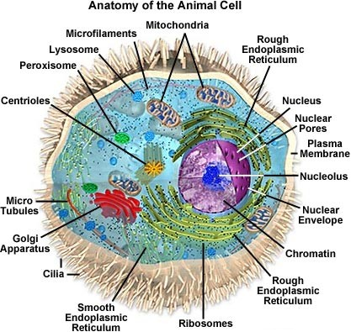
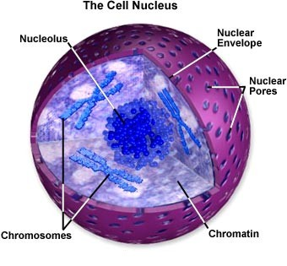
Biological Background (1) – The cell
  Every creature cell is a complex of many small “factories” working together
  The center is the cell nucleus
  The nucleus contains the genetic information

Slide 8
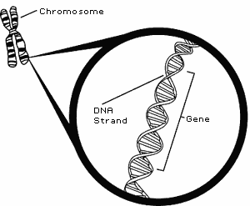
Biological Background (2) – Chromosomes
  Genetic information is stored in the chromosomes
  Each chromosome is build of DNA
  Chromosomes in humans form pairs
  There are 23 pairs
  The chromosome is divided in parts: genes
  Genes code for properties
  The posibilities of the genes for one property is called: allele
  Every gene has an unique position on the chromosome: locus

Slide 9
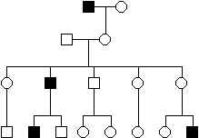
Biological Background (3) – Genetics
  The entire combination of genes is called genotype
  A genotype develops to a phenotype
  Alleles can be either dominant or recessive
  Dominant alleles will always express from the genotype to the phenotype
  Recessive alleles can survive in the population for many generations, without being expressed.

Slide 10
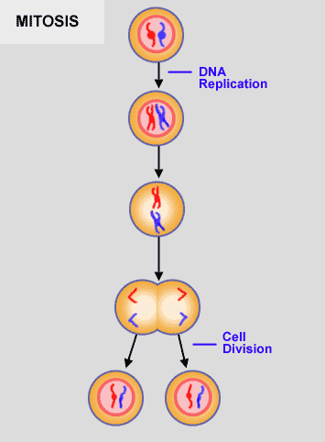
Biological Background (4) – Reproduction
  Reproduction of genetical information
    Mitosis
    Meiosis
  Mitosis is copying the same genetic information to new offspring: there is no exchange of information
  Mitosis is the normal way of growing of multicell structures, like organs.

Slide 11
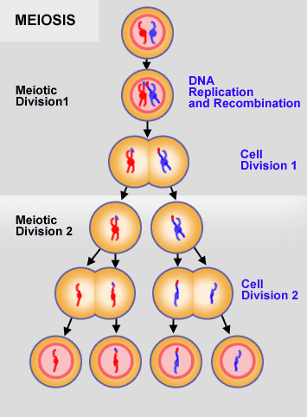
Biological Background (5) – Reproduction
  Meiosis is the basis of sexual reproduction
  After meiotic division 2 gametes appear in the process
  In reproduction two gametes conjugate to a zygote which will become the new individual
  Hence genetic information is shared between the parents in order to create new offspring

Slide 12
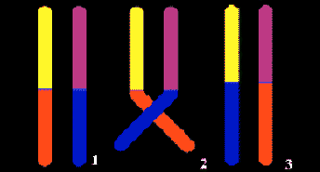
Biological Background (6) – Reproduction Errors
  During reproduction “errors” occur
  Due to these “errors” genetic variation exists
  Most important “errors” are:
    Recombination (cross-over)
    Mutation

Slide 13
Biological Background (7) – Natural selection
  The origin of species: “Preservation of favourable variations and rejection of unfavourable variations.”
  There are more individuals born than can survive, so there is a continuous struggle for life.
  Individuals with an advantage have a greater chance for survive: survival of the fittest.

Slide 14
Biological Background (8) – Natural selection
  Important aspects in natural selection are:
    adaptation to the environment
    isolation of populations in different groups which cannot mutually mate
  If small changes in the genotypes of individuals are expressed easily, especially in small populations, we speak of genetic drift
  Mathematical expresses as fitness: success in life

Slide 15
Evolutionary Computation
Natural Evolution
  Generating a population of individuals with increasing fitness
  Increasing ability to survive and reproduce in a specific environment
Evolutionary Computation
  Simulate the natural evolution on a computer
  Generate a set of solutions to a problem of increasing quality

Slide 16
Terminology
Individual
  Candidate solution to a problem
Chromosome
  Representation of the candidate solution
Gene
  Constituent entity of the chromosome
Population
  Set of individuals/chromosomes
Fitness Function
  Representation of how good a candidate solution is
Genetic operators
  Operators applied on chromosomes in order to create genetic variation (other chromosomes)

Slide 17
Terminology
Biology Problem Solving
Environment Problem
Individual Candidate Solution
Fitness Quality
Natural Selection Selection

Slide 18
Summary
Darwinian Evolution
Biological Background
Evolutionary Computation

Slide 19
What I want you to do
Review Chapter 3
Work on your assignment
Organize your project team

